Slide 1
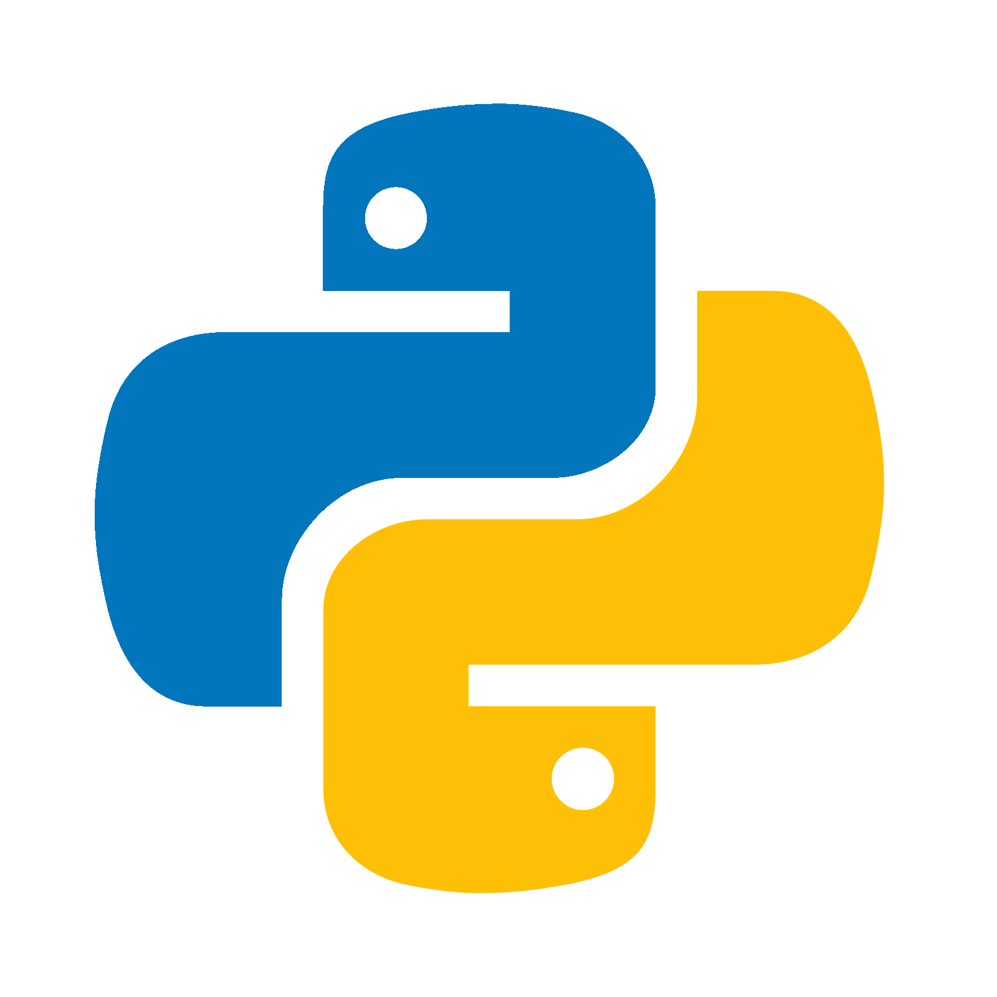
Python Programming (28521)
Palash Biswas
Jr. Instructor, Computer Science And Technology
Gopalganj Polytechnic Institute

Slide 2
Experiment No: 01 Date: / /
Name of Experiment: Write & execute programs using variables & operators.
Necessary Instruments:
Personal Computer (Laptop/Desktop)
Python Software
Pycharm IDE
Internet Connection
Objective: To gain knowledge about executing programs using variables & operators.
Working Procedure:
Program No: 01
Name of Program: Write a Python program to display the sentence “Hello World” on the monitor screen.
Code:
print(“Hello World”)
............................................................................................................................... Output:
Hello World
...............................................................................................................................
Program No: 02
Name of Program: Write a Python program to calculate addition, subtraction, multiplication and division between two numbers.
Code:
a = int(input(“Enter the first number : ”))
b = int(input(“Enter the second number : ”))
sum = a + b
sub = a – b
mul = a * b
div = a / b

Slide 3
print(“A + B = ”, sum)
print(“A - B = ”, sub)
print(“A * B = ”, mul)
print(“A / B = ”, div)
............................................................................................................................... Output:
Enter the first number : 4
Enter the second number : 2
A + B = 6
A - B = 2
A * B = 8
A / B = 2
...............................................................................................................................
Carefulness: Ensure input validation for numerical values, maintain correct syntax and indentation, and define and call functions appropriately. Verify mathematical operations and logical conditions for accuracy.
Remark: Both programs effectively use variables and operators to handle conditions based on user input, providing clear prompts and correct outputs.
Course Teacher Head of the Dept. Principal

Slide 4
Experiment No: 02 Date: / /
Name of Experiment: Write & execute programs using branching statements.
Necessary Instruments:
Personal Computer (Laptop/Desktop)
Python Software
Pycharm IDE
Internet Connection
Objective: To gain knowledge about executing programs using branching statements.
Working Procedure:
Program No: 01
Name of Program: Write a Python program to find the biggest number from three numbers.
Code:
def max3val():
a = int(input(“Enter first number =”))
b = int(input(“Enter second number =”))
c = int(input(“Enter third number =”))
if (a>b) and (a>c):
print(“A is maximum and it is :”, a)
elif (b>c):
print(“B is maximum and it is :”, b)
else:
print(“C is maximum and it is :”, c)
max3val()
............................................................................................................................... Output:
Enter first number = 81
Enter second number = 25
Enter third number = 59
A is maximum and it is : 81
...............................................................................................................................

Slide 5
Program No: 02
Name of Program: Write a Python program to calculate triangle area using function.
Code:
import math
def triangle_area():
a = float(input(“Enter first arm length=”))
b = float(input(“Enter second arm length =”))
c = float(input(“Enter third arm length =”))
if (a+b)>c and (b+c)>a and (a+c)>b:
s = (a+b+c)/2
area = math.sqrt(s*(s-a)*(s-b)*(s-c))
print(“Triangle area is = ”, area)
else:
print(“Triangle is not possible”)
triangle_area()
............................................................................................................................... Output:
Enter first arm length = 7
Enter second arm length = 9
Enter third arm length = 6
Triangle area is = 20.97617696340303
...............................................................................................................................
Carefulness: Ensure input validation for numerical values, maintain correct syntax and indentation, and define and call functions appropriately. Verify mathematical operations and logical conditions for accuracy.
Remark: Both programs effectively use branching statements to handle conditions based on user input, providing clear prompts and correct outputs.
Course Teacher Head of the Dept. Principal

Slide 6
Experiment No: 03 Date: / /
Name of Experiment: Write & execute programs using looping statements.
Necessary Instruments:
Personal Computer (Laptop/Desktop)
Python Software
Pycharm IDE
Internet Connection
Objective: To gain knowledge about executing programs using looping statements.
Working Procedure:
Program No: 01
Name of Program: Write a Python program to print even numbers from 1 to n.
Code:
n = int(input(“Enter the end of Range = ”))
print(“Printing of Even Number Series:”)
for i in range(1, n+1):
if not(i%2):
print(i, end=“ ”)
............................................................................................................................... Output:
Enter the end of Range = 50
Printing of Even Number Series: 2 4 6 8 10 12 14 16 18 20 22 24 26 28 30 32 34 36 38 40 42 44 46 48 50
...............................................................................................................................
Program No: 02
Name of Program: Write a Python program to print prime numbers from 1 to n.
Code:
lower_value = int(input(“Enter the lowest range value : ”))
upper_value = int(input(“Enter the upper range value : ”))
print(“The prime numbers in the range are : ”)
for number in range (lower_value, upper_value+1):
if number > 1:
for i in range(2, number):
if (number % i) == 0:

Slide 7
break
else:
print(number, “ ”, end=“ ”)
............................................................................................................................... Output:
Enter the lowest range value: 9
Enter the upper range value: 66
The prime numbers in the range are :
11 13 17 19 23 29 31 37 41 43 47 53 59 61 ...............................................................................................................................
Carefulness: Ensure input validation for numerical values, maintain correct syntax and indentation, and define and call functions appropriately. Verify mathematical operations and logical conditions for accuracy.
Remark: Both programs effectively use looping statements to handle conditions based on user input, providing clear prompts and correct outputs.
Course Teacher Head of the Dept. Principal

Slide 8
Experiment No: 04 Date: / /
Name of Experiment: Write & execute programs using lists/array.
Necessary Instruments:
Personal Computer (Laptop/Desktop)
Python Software
Pycharm IDE
Internet Connection
Objective: To gain knowledge about executing programs using lists/array.
Working Procedure:
Program No: 01
Name of Program: Write a Python program to take input in lists and find smallest and largest numbers from the lists using function.
Code:
def find_min_max():
n = int(input("Enter the number of elements in the list: "))
lst = []
for i in range(n):
elem = int(input(f"Enter element {i+1}: "))
lst.append(elem)
smallest = min(lst)
largest = max(lst)
print(f"The smallest number is: {smallest}")
print(f"The largest number is: {largest}")
find_min_max()
............................................................................................................................... Output:
Enter the number of elements in the list: 5
Enter element 1: 12
Enter element 2: 4
Enter element 3: 19
Enter element 4: 1
The smallest number is: 1
The largest number is: 19
...............................................................................................................................

Slide 9
Program No: 02
Name of Program: Write a Python program to calculate the sum of the elements in a list.
Code:
def sum_of_list():
n = int(input("Enter the number of elements in the list: "))
lst = []
for i in range(n):
elem = int(input(f"Enter element {i+1}: "))
lst.append(elem)
total_sum = sum(lst)
print(f"The sum of the elements in the list is: {total_sum}")
sum_of_list()
............................................................................................................................... Output:
Enter the number of elements in the list: 5
Enter element 1: 12
Enter element 2: 4
Enter element 3: 19
Enter element 4: 1
Enter element 5: 8
The sum of the elements in the list is: 44
...............................................................................................................................
Carefulness: Ensure input validation for numerical values, maintain correct syntax and indentation, and define and call functions appropriately. Verify mathematical operations and logical conditions for accuracy.
Remark: Both programs effectively use lists operation to handle conditions based on user input, providing clear prompts and correct outputs.
Course Teacher Head of the Dept. Principal

Slide 10
Experiment No: 05 Date: / /
Name of Experiment: Write & execute programs using a dictionary.
Necessary Instruments:
Personal Computer (Laptop/Desktop)
Python Software
Pycharm IDE
Internet Connection
Objective: To gain knowledge about executing programs using dictionary.
Working Procedure:
Program No: 01
Name of Program: Write a Python program to create a empty dictionary.
Code:
my_dict_one = {}
my_dict_two = {}
print(my_dict_one)
print(my_dict_two)
............................................................................................................................... Output:
{}
{}
...............................................................................................................................
Program No: 02
Name of Program: Write a Python program to add and print elements in a dictionary.
Code:
my_cars = {}
print(“My empty dict: ”, cars)
my_cars.setdefault(‘Cars’[]).append(“BMW”)
print(“First item added: ”, my_cars)
my_cars.setdefault(‘Cars’[]).append(“Toyota”)
print(“Second item added: ”, my_cars)

Slide 11
my_cars.setdefault(‘Cars’[]).append(“Honda”)
print(“Third item added: ”, my_cars)
............................................................................................................................... Output:
My empty dict: {}
First item added: {‘Cars’: [‘BMW’]}
Second item added: {‘Cars’: [‘BMW’, ‘Toyota’]}
Third item added: {‘Cars’: [‘BMW’, ‘Toyota’, ‘Honda’]}
...............................................................................................................................
Carefulness: Ensure input validation for numerical values, maintain correct syntax and indentation, and define and call functions appropriately. Verify mathematical operations and logical conditions for accuracy.
Remark: Both programs effectively use dictionary operation to handle conditions based on user input, providing clear prompts and correct outputs.
Course Teacher Head of the Dept. Principal

Slide 12
Thank You

